Slide 2
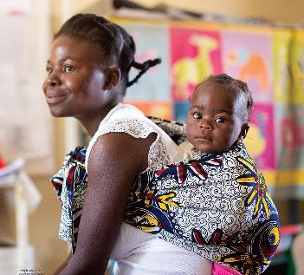
Better Nutrition, Better Tomorrow
Last year, Bread focused its Offering of Letters on global nutrition so mothers and children could get the foods they need to lead healthy and fulfilling lives.
This year, in addition to continuing our advocacy around global nutrition, we also turn our attention to children experiencing hunger in the U.S.

Slide 3
Malnutrition remains a leading cause of child deaths globally.
Global hunger and poverty rates have been cut nearly in half during the past 30 years.
Still, more than 1 in 5 children under age five are not growing as they should.
And millions are dangerously thin.

Slide 4
In the U.S., 1 in 7 children live in food-insecure homes.
Children who suffer food insecurity have more headaches, colds and other illnesses than children who never went hungry.
Summer is the hungriest time of the year. Fewer than 1 in 5 U.S. children who receive school meals benefit from summer nutrition programs, leaving millions without adequate nutrition.

Slide 5
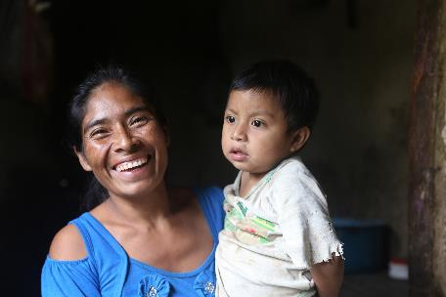
Our Goals:
Increase funding for nutrition programs in the U.S., including Summer EBT.
Support legislation that strengthens U.S. leadership and increases funding for global nutrition.

Slide 6
Key Components of a
Letter to Congress
Make it personal. Describe what motivated you to write.
Make your request clear.
Include your address in the letter.

Slide 7
Dear Congress:
I urge you to make strong investments in nutrition programs for the most vulnerable in the U.S. and abroad, especially mothers and children.
Federal nutrition programs help U.S. families lead healthy lives. Congress should increase funding for the Summer EBT program so more children can access nutritious food during the summer months—the hungriest time of the year for children.
I also urge you to support legislation that strengthens U.S. leadership on global nutrition and increases funding for global nutrition programs. Too many children globally are malnourished and suffer from stunting. Stunting affects physical and cognitive development.
My faith calls me to stand alongside women and children around the world. Our government should provide leadership toward a well-nourished world.
Sincerely,
[Your Name and Address]

